Slide 1
Scientific Posters
What they are and why you need to ignore what they’ve been

Slide 2

The basics
Big piece of paper with stuff on it
Stuff usually describes a study
The study needs context
With context, your information becomes a story
Notes:
This is a generic poster from a google search. This slide discusses the basic structure

Slide 3
Sections
Title
Authors
Affiliation
Contact
Introduction
Methods
Results
Conclusions
References
Acknowledgements
Notes:
This slide is a deeper dive, mentioning the specific sections you typically see on a poster

Slide 4
Sections
Title
Authors
Affiliation
Contact
Introduction
Methods
Results
Conclusions
References
Acknowledgements
Always include this
Notes:
Pan along the poster and highlight the specific sections, what they convey

Slide 5
Sections
Title
Authors
Affiliation
Contact
Introduction
Methods
Results
Conclusions
References
Acknowledgements
“context”

Slide 6
Sections
Title
Authors
Affiliation
Contact
Introduction
Methods
Results
Conclusions
References
Acknowledgements
“how?”

Slide 7
Sections
Title
Authors
Affiliation
Contact
Introduction
Methods
Results
Conclusions
References
Acknowledgements
Why someone bothered to look at your poster

Slide 8
Sections
Title
Authors
Affiliation
Contact
Introduction
Methods
Results
Conclusions
References
Acknowledgements
Closing thoughts, future directions

Slide 9
Sections
Title
Authors
Affiliation
Contact
Introduction
Methods
Results
Conclusions
References
Acknowledgements
Credit given where it’s due

Slide 10

Sections
Title
Authors
Affiliation
Contact
Introduction
Methods
Results
Conclusions
References
Acknowledgements
Notes:
“Notice that this follows the same structure as scientific manuscripts”

Slide 11
Sections
Title
Authors
Affiliation
Contact
Introduction
Methods
Results
Conclusions
References
Acknowledgements
Poster
Paper
Notes:
First big hot take: POSTERS ARE NOT PAPERS, stop acting like they are

Slide 12
Sections
Poster
Title
Authors
Affiliation
Contact
Introduction
Methods
Results
Conclusions
References
Acknowledgements
why bother?
what you did
outcome
ok cool, what now?
credits, could be QR code
You’re narrating a story
Notes:
A poster narrates a visual story of work. This slide generalizes the sections presented earlier into what you ultimately need to communicate in a poster

Slide 13
Notes:
“Let’s explore the visual flow of the poster”

Slide 14
Player 1 Start
Player 1 Finish
Notes:
If you’re reading things in order, this is the path your eyes would take to navigate this poster. Hot take: It’s a bad path b/c it’s very inconsistent. It’s not a natural path.

Slide 15
Player 1 Start
Player 1 Finish
Notes:
Same thing, except I also mapped out how your eyes are expected to travel the results section. Last time I presented this, I finished by saying “This is the work of a psychopath”.

Slide 16
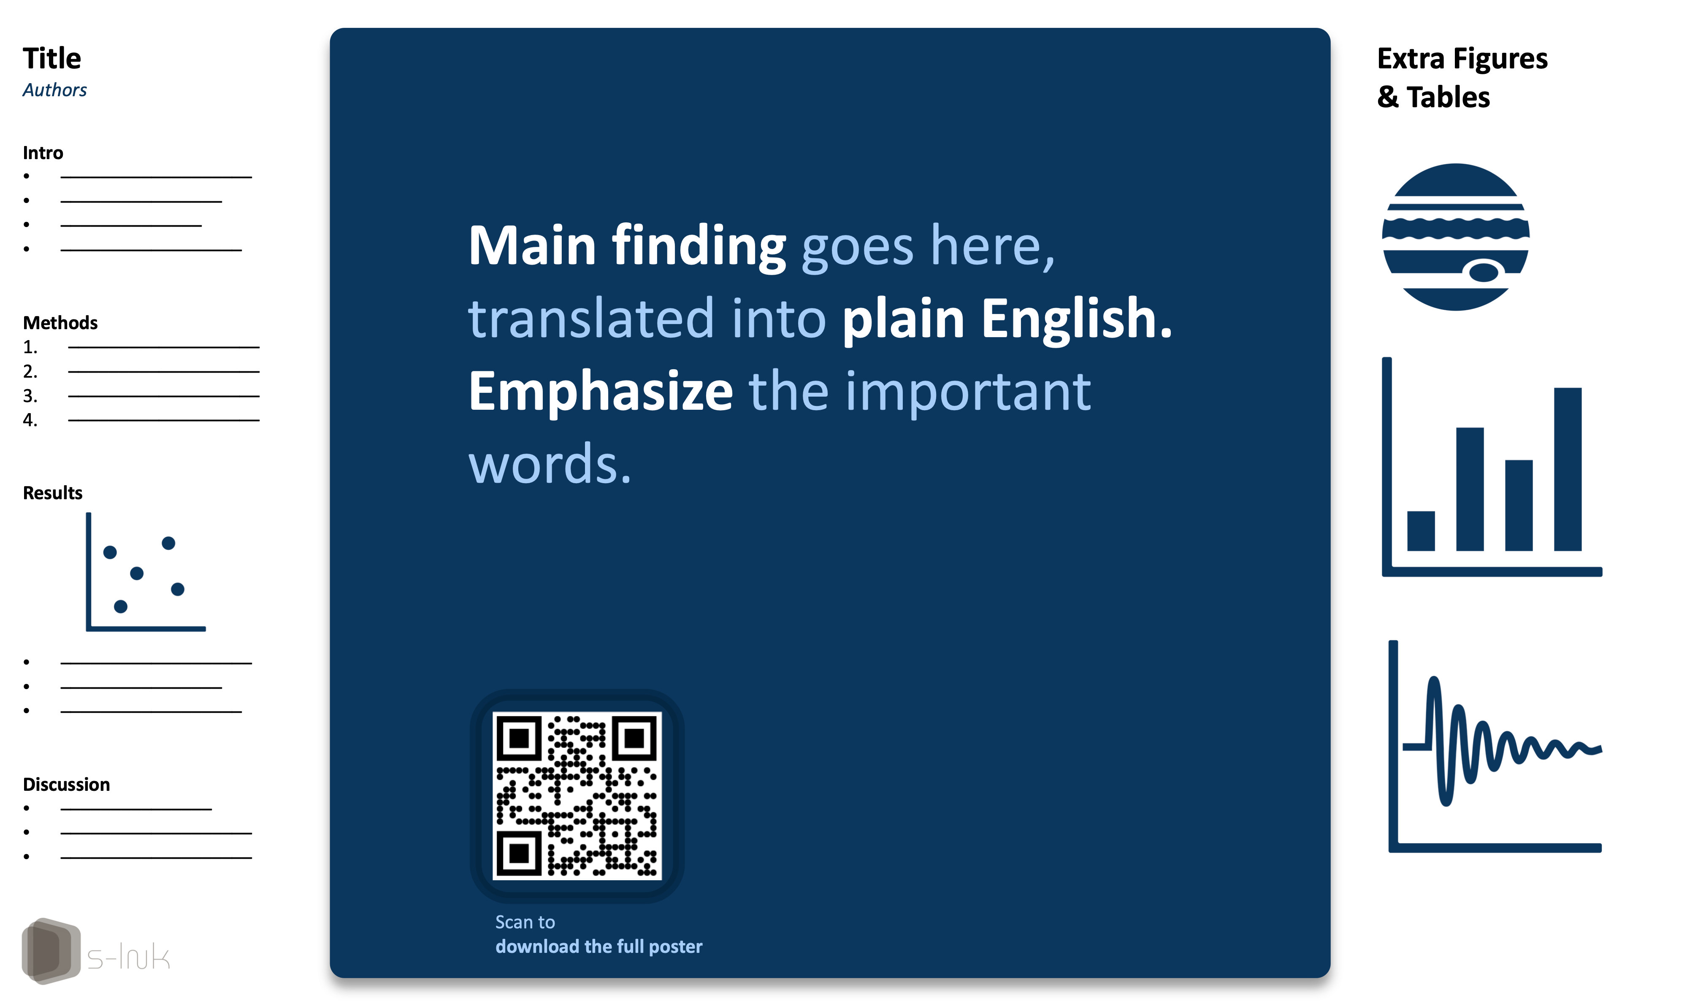
Notes:
This presents “Better Posters” as an existing alternative to the “classic” poster design. I discuss the rationale and structure (the next slide criticizes it)

Slide 17



Notes:
Despite the rationale for the structure, people still make the same mistakes WITH LESS SPACE. Wordy. Everything is so small and wordy on the sides

Slide 18


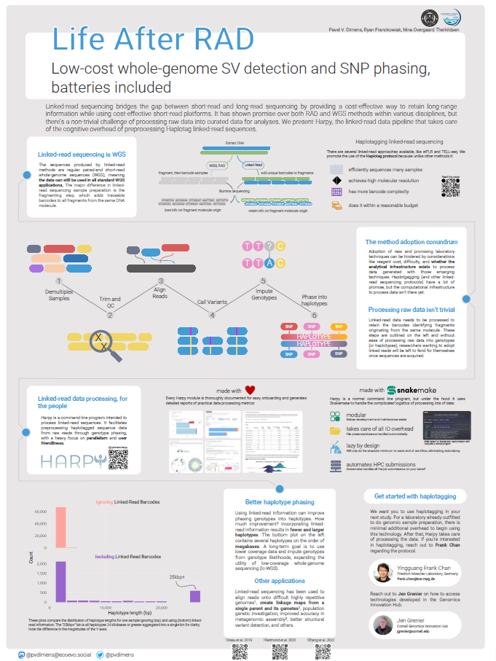
Notes:
This and the next two slides are a stroll down memory lane of the only 3(!) posters I’ve first-authored, arranged in chronological order. The point is to show “yeah, I sucked too, but I got better over time. If there’s time, I love letting the audience dunk on this poster and point out everything wrong with it. It’s from my undergrad.

Slide 19
Notes:
This poster is from my Masters. It begins to show the transition from TELLING to SHOWING. There are only 4 complete sentences on this poster. The figure on the top-left is the synthesis of ~6 papers

Slide 20

Notes:
My most recent poster. Again, transitioning more into showing vs telling. Text is light and simple, lots of simple figures to convey complex ideas, and there is a track to tell your eyes how to travel along the poster.

Slide 21

Say less
Show more
Notes:
This synthesizes the idea that you will be PRESENTING your poster, standing beside and discussing it to an audience. If you SHOW things, you can use them as references for what you’re discussing. Don’t expect people to listen and engage with you while trying to consume all the text on the poster.

Slide 22
Say less
Show more
Notes:
All of which converges on this idea of saying less (text) and showing more (clear figures and diagrams).

